Slide 1


DRIVERS OF LACTATE RESPONSE Levels of Lactate, factors associated and mortality in sepsis
TEAM N.3
Giovana Gavidia
Sandra Canelles
Gerard Moreno
Chris Cosgriff
Chris Sauer
María Bodí

Slide 2


Lactate and mortality in sepsis
My patient has a normal lactate. Phew! I'm already calm!

Slide 3
INCLUSION CRITERIA
> 18 y
SEPSIS. Angus definition (+). Angus DC. Crit Care Med. 2001 Jul;29(7):1303-10.
≥ 1 lactate determination (-6 to 24 h ICU admission)
11269
Septic patients
5891
Inclusion criteria
EXCLUSION CRITERIA
Comorbidities (Cancer, liver dis, DM)
> first admission ICU
Exclusion | n
Cancer (140.00-239.2) | 681
DM (24900-25099) | 2875
Liver Dis (57000-57339) | 19
Lactate values before -6 h | 360
Hospimtal Ad
ICU Adm
ICU 24 h
6 h
24 h

Slide 4
Variables
Age (Intime-DOB), sexo (GENDER), ethnicity (ETNICITY)
Lactate time
SCORES at admission (SOFA)
Comorbidities: Elixhauser comorbidity measures. van Walraven C. Med Care. 2009
Laboratory results (Glucose, K, Na, Creatinin, BUN, Hemoglobin,WBC, Platelet, PTT, INR, PT)
Organ failure-Support:
CRR, MV, VA drugs
Notes:
APACHE: https://github.com/MIT-LCP/mimic-code/blob/master/concepts/severityscores/apsiii.sql

Slide 5
Lactate levels and mortality (28 d)
Lactate ≤ 2 mmol/l (n=2595) | Lactate > 2 mmol/l (n=3296)
594 (22,9%) | 988 (29,9%)

Slide 6




Data Analysis Framework
Main Stages involved in the data analysis
1
2
3
4
Data Collection
Data Preprocessing
Exploratory Data Analysis and Profiling
Estimation of Change
- MIMMIC 3 databases
Merging datasets
Creating new variables
Data visualisation in the short and long-term
Relationships
- Define the target variable
- Predict the change of our target variable.
70% of time

Slide 7
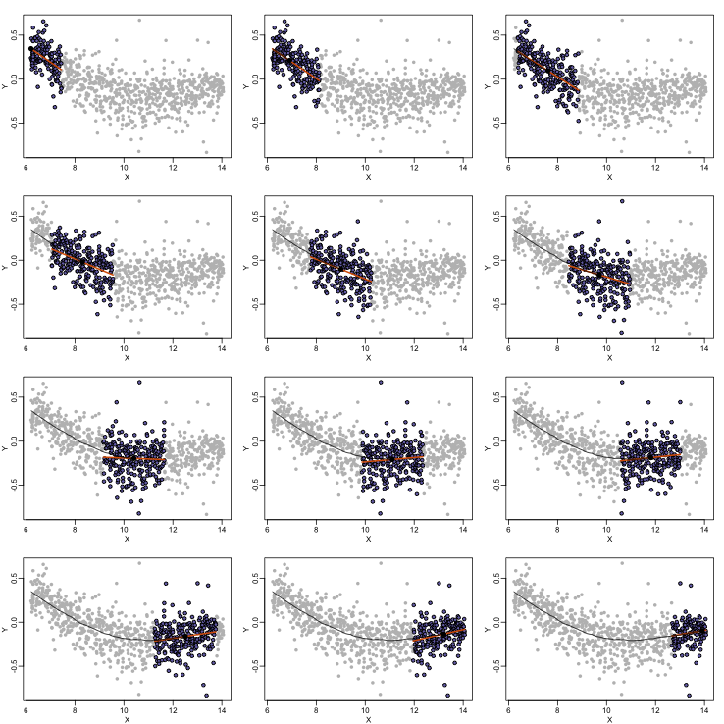
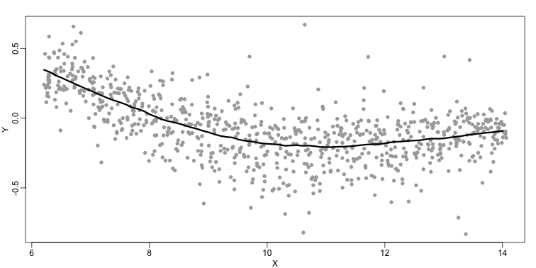
Non-linear data modelling
Local weighted regression (LOESS) curves
It moves along data looking at data chunks to fit local regression lines
Source: http://genomicsclass.github.io/book/pages/smoothing.html
LOESS: non-parametric regression method applied to observe trends on non-lineal data
Local regression lines are connected to make a smooth line

Slide 8
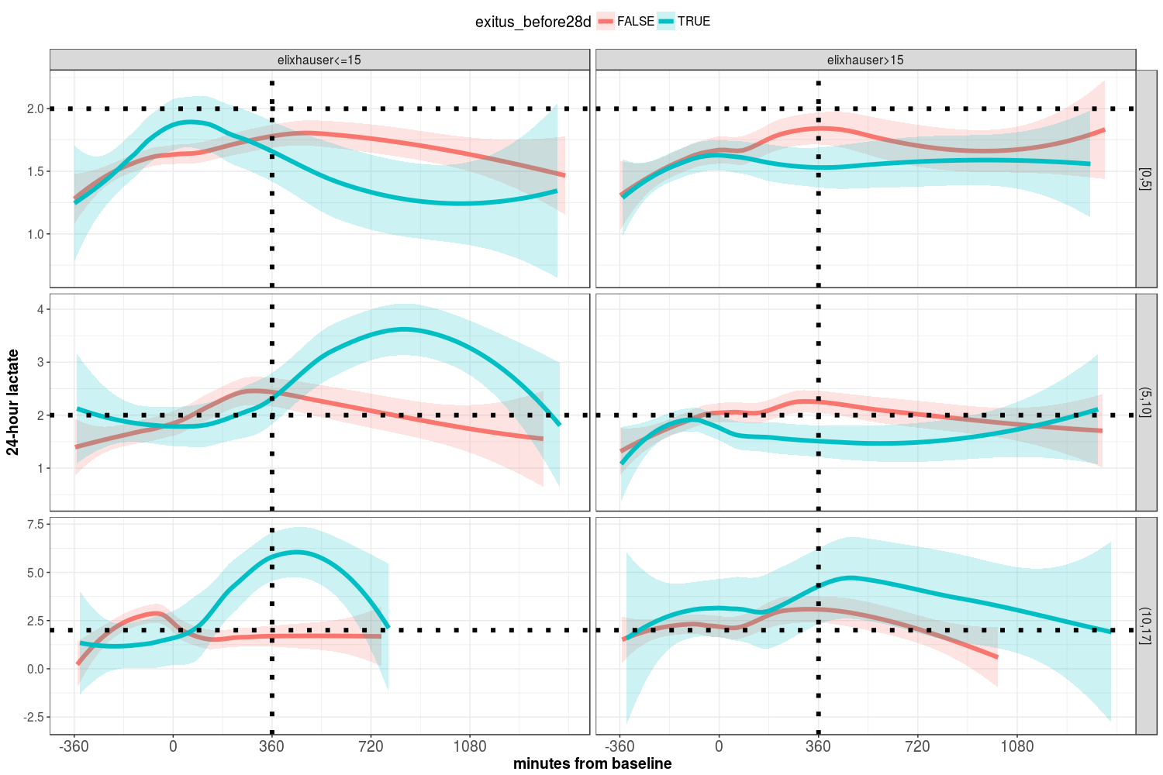
Lactate change in population with lower lactate at bs

Slide 9
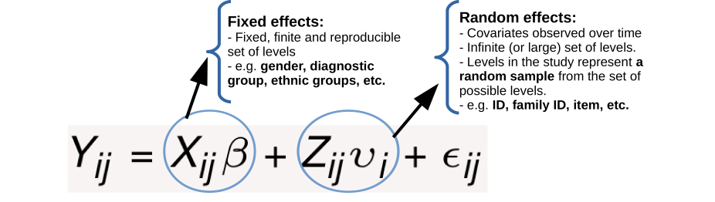
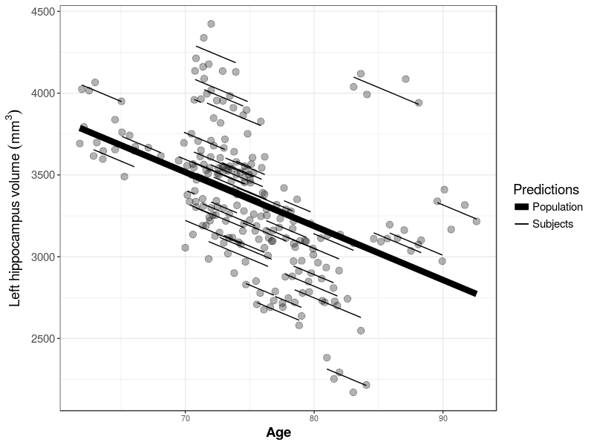
Multivariate models to estimate the change of the target variables
Linear Mixed-Effects (LME) Modelling
LME models offer a powerful and versatile framework for analysing real-life longitudinal data
Within-individual variability
response
Between individual variability
time

Slide 10
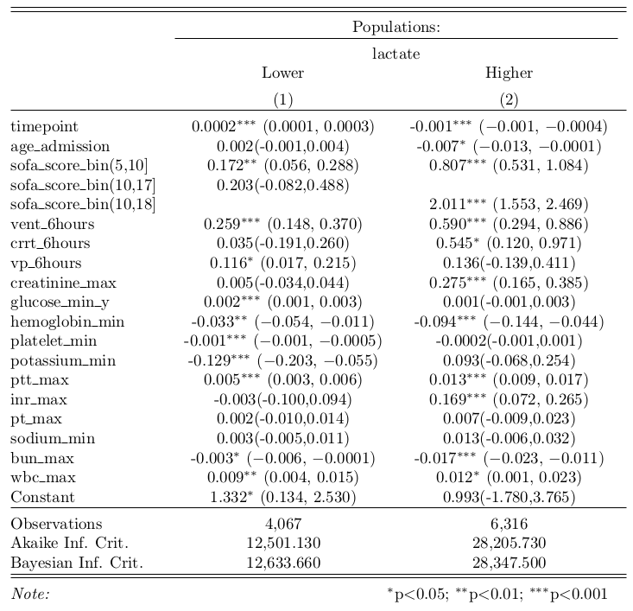

Slide 11
Next steps
Identify factors associated to mortality in patients with lower lactate at baseline
Reflexions
It is easier for clinicians and data scientist to have a more pre-processed data before starting the analysis.
Thank you

